Slide 1

Lecture 4-2 I/O Pins, IP, Interconnects, Memory, Clocks
Assignment and References
Basic I/O Devices on the Zybo Board
Vivado, IP Integrator and SDK
Embedded System Design with Zybo
I/O Pins of ZYNQ XC7Z010-1CLG400C Chip
Lab #3 Part 2 (ZYNQ 2) Adding IP Soft Cores in PL
MIO Pins on Processing System (PS) Side
MUX IO (MIO), Bank 0 and Bank 1
DDR
EMIO Pins on Programmable Logic (PL) Side
SelectIO or Extended MUX IO (EMIO) for ARM Core
PS-PL Interfaces, AXI Interconnects
Master, Slave, Coherency, High Performance Ports
Memory Map of ARM

Slide 2
Assignment and References
Lab #3 Block Design and IPs Creation on Zybo
Zynq Lab Workbook for Lab 1: Simple Hardware Design with Zynq ARM cores only
Zynq Lab Workbook for Lab 2: Adding IPs in Programmable Logic to Add Your Own Peripheral
References:
ZYBO Reference Manual, 2014 (pdf)
The Zynq Book (pdf)
Zynq-7000 All Programmable SoC, Technical Reference Manual, 2015
Zynq-7000 All Programmable S
AMBA™ 3 APB ProtocoloC Overview
7 Series FPGAs SelectIO Resources, User’s Guide, 2015
AXI Reference Guide, Xilinx, 2012

Slide 3
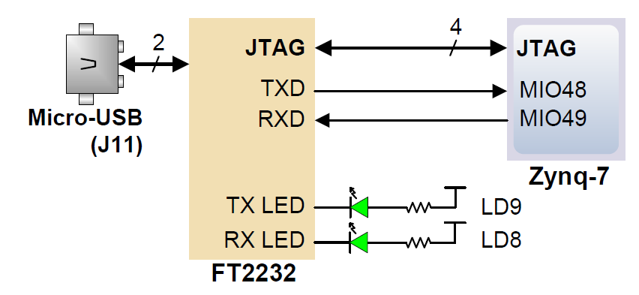
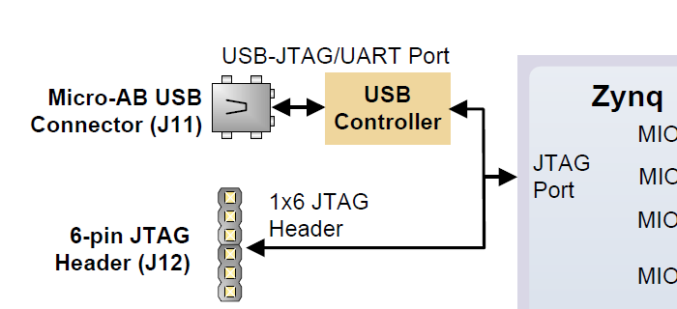
USB-UART and JTAG Bridge on the Zybo Board
The board definition file takes care of mapping the correct MIO pins to the UART 1 controller and uses the following default protocol parameters: 115200 baud rate, 1 stop bit, no parity, 8-bit character length.
The FT2232HQ is also used as the controller for the Digilent USB-JTAG circuitry, but the USB-UART and USB-JTAG functions behave entirely independent of one another.
JTAG interface is used to program, execute and debug the chip
ZYNQ PL can be programmed directly from Vivado through JTAG

Slide 4
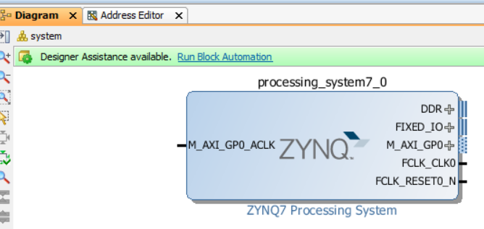
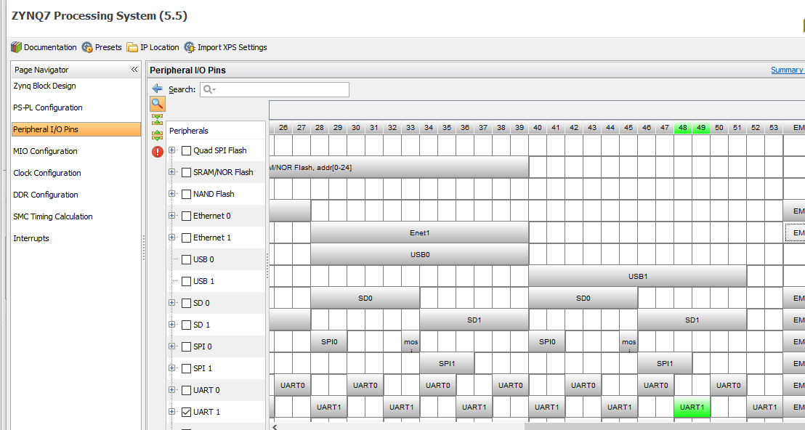
UART1 on MIO48 and MIO49
Make sure to choose “Run Block Automation” when adding Zynq block so that UART 1 is configured correctly.
Double click on ZYNQ block and choose Peripheral I/O Pins

Slide 5
Vivado, IP Integrator and SDK
Vivado is the tool suite for Xilinx FPGA design and includes capability for embedded system design
IP Integrator, is part of Vivado and allows system level design of the hardware part of an Embedded system Integrated into Vivado
Vivado includes all the tools, IP, and documentation that are required for designing systems with the Zynq-7000 AP SoC hard core and/or Xilinx MicroBlaze soft core processor
SDK is an Eclipse-based software design environment
Enables the integration of hardware and software components
Links from Vivado
Vivado is the overall project manager and is used for developing non-embedded hardware and instantiating embedded systems

Slide 6
Vivado Components
Vivado/IP Integrator
Design environment for configuration of PS, and hardware design for PL
Hardware Platform (xml), Board File
Platform, software, and peripheral simulation
Vivado logic analyzer integration
Software Development Kit (SDK)
Project workspace
Hardware platform definition
Board Support Package (BSP)
Software application
Software debugging
Hardware Design
HW/SW Simulation
Software Design
HW/SW Debug

Slide 7
Embedded System Tools: Hardware
IP – Hardware components in Verilog or VHDL or other hardware description language or on silicon, similar to software library routines
IP hard cores – ARM cores
IP soft cores – hardware components in Verilog or VHDL provided by Xilinx or created by users
IP Integrator
IP Packager
Hardware netlist generation
Simulation model generation
Xilinx Microprocessor Debugger (XMD)
Hardware debugging using Vivado analyzer
Board Files to describe hardware components on a board
https://github.com/Digilent/vivado-boards/archive/master.zip.

Slide 8
Embedded System Tools: Software
Eclipse IDE-based Software Development Kit (SDK)
Board support package creation
GNU software development tools
C/C++ compiler for the MicroBlaze and ARM Cortex-A9 processors (gcc)
Debugger for the MicroBlaze and ARM Cortex-A9 processors (gdb)
TCF framework – multicore debug
Board support packages (BSPs) – Libraries of drivers
Stand-alone BSP
Free basic device drivers and utilities from Xilinx
NOT an RTOS

Slide 9
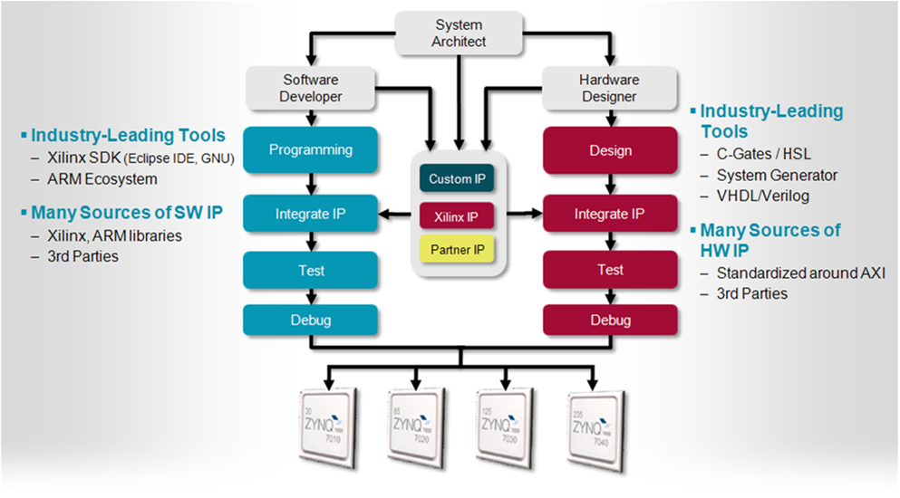
Embedded System Design Flow for Zynq-7000 AP SoC

Slide 10
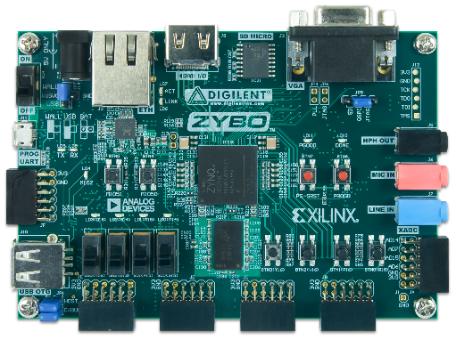
Embedded System Design with Zybo
1. Launch Vivado
3. Configure PS settings
4. Add IP & configure
(close Block Diagram, return to Vivado)
2. Invoke IP Integrator to create Block Diagram
5. Generate Top-Level HDL
6. Add Constraints
7. Generate Bitstream => .bit
8. Export hardware to SDK
9. Specify hardware description from Vivado
10. Add Software Project & Build => .elf
Hardware Configuration
IP Integrator
SDK
Vivado
11. Program bitstream & .elf into Zynq
ZYBO

Slide 11
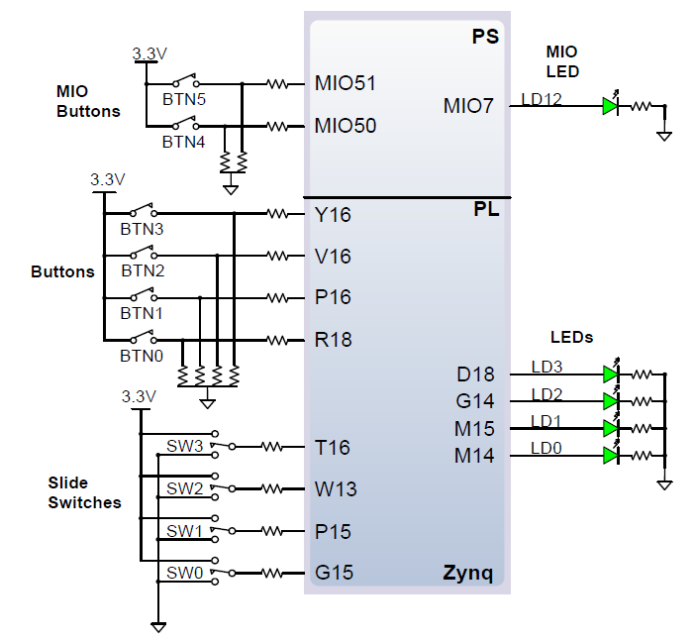
Basic I/O Devices on the Zybo Board
Each peripheral device such as buttons, switches and LEDs are connected to one I/O pin on the Zynq chip
MIO pins are connected directly to ARM cores
Y16, V16, etc. are pins from FPGA side
I/O devices are defined in Zybo board interface files

Slide 12
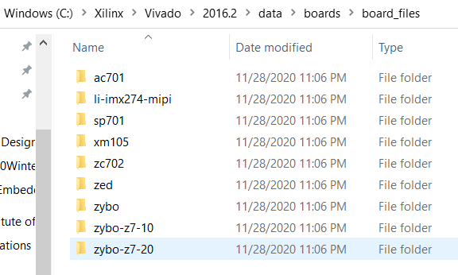
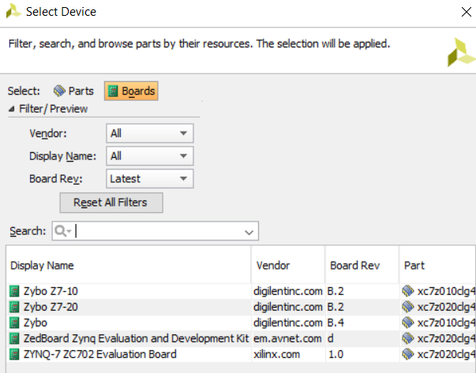
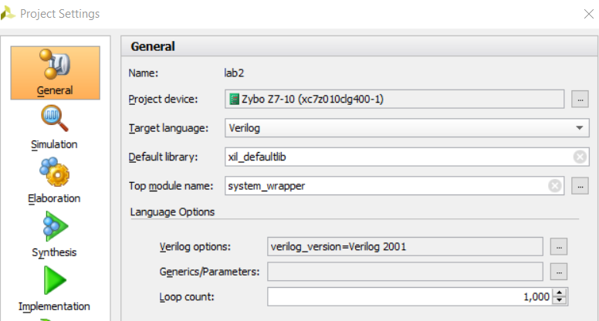
Lab #3 Part 2: (ZYNQ 2) Adding Soft IP Cores in PL
Choose Zybo Board Interface (Support) File in C:\Xilinx\Vivado\2015.2\data\boards\board_files.

Slide 13
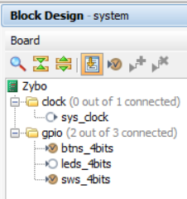
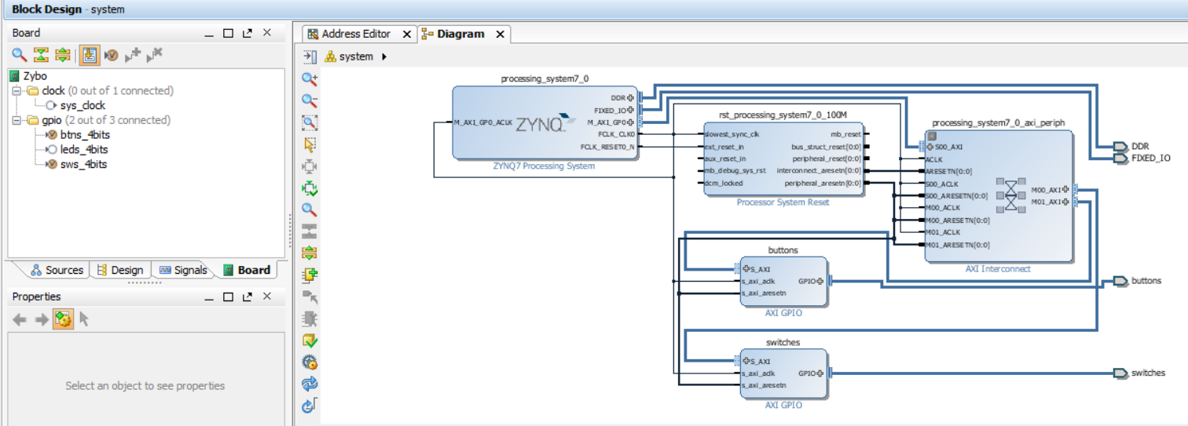
Lab #3 Part 2: (ZYNQ 2) Adding Soft IP Cores in PL
Open Block Design to see board I/O interfaces
Buttons, Slide Switches and LEDs are defined
These ports can be assigned to GPIO soft IP blocks

Slide 14
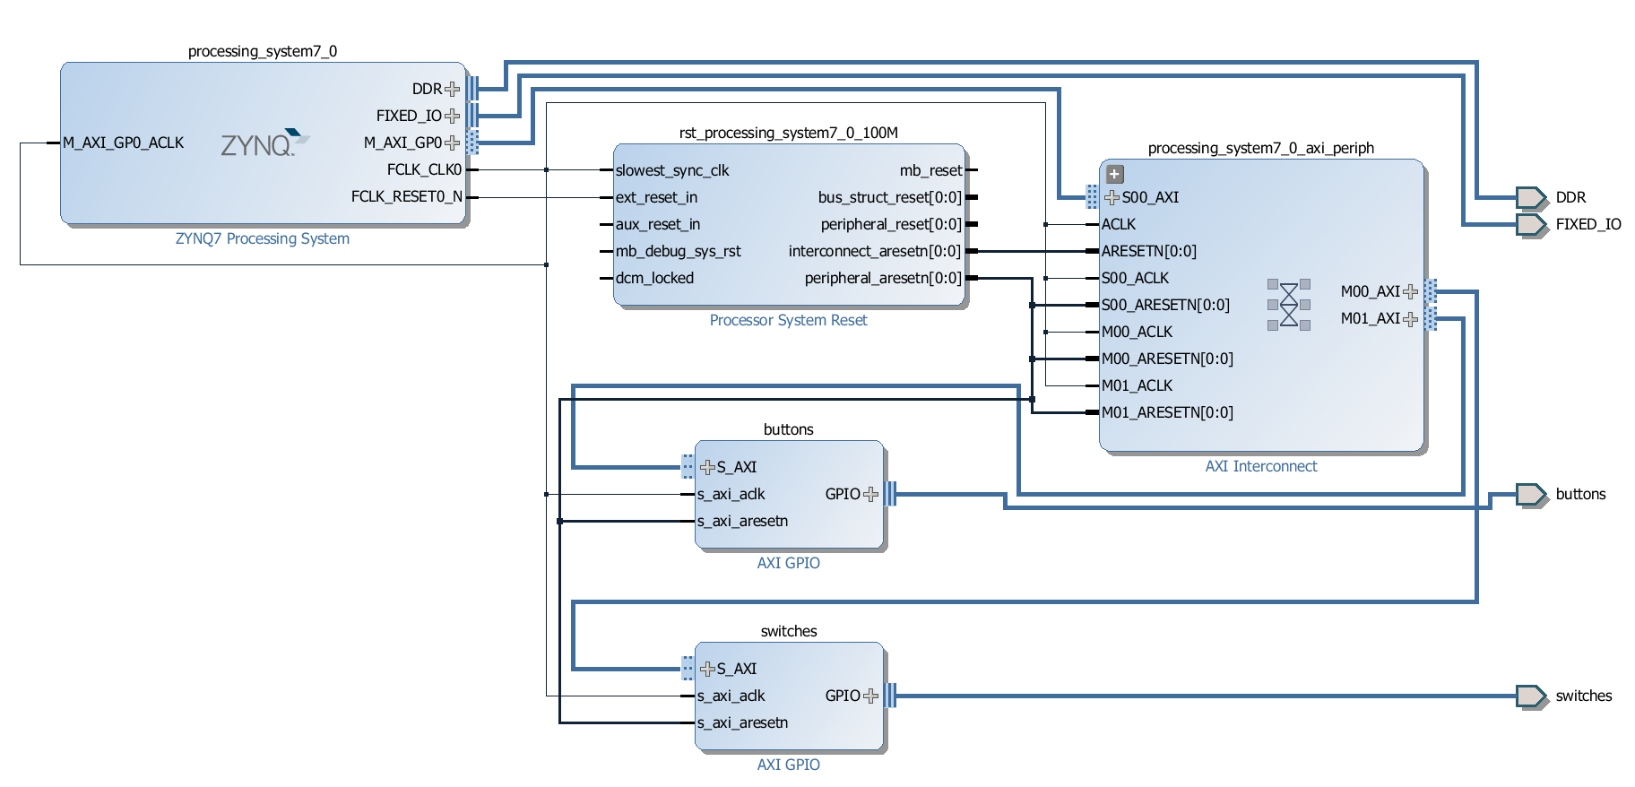
Lab #3 Part 2: (ZYNQ 2) Adding Soft IP Cores in PL
AXI Interconnect Ports are IP cores (soft cores)
To connect ARM hard core CPUs to I/O pins for switches and buttons through software IP cores
buttons and switches are accessible from ARM CPU
AXI crossbar
switch soft cores
ARM hard core
EMIO pins
AXI interconnect
soft core
AXI interconnect
soft core
EMIO pins

Slide 15
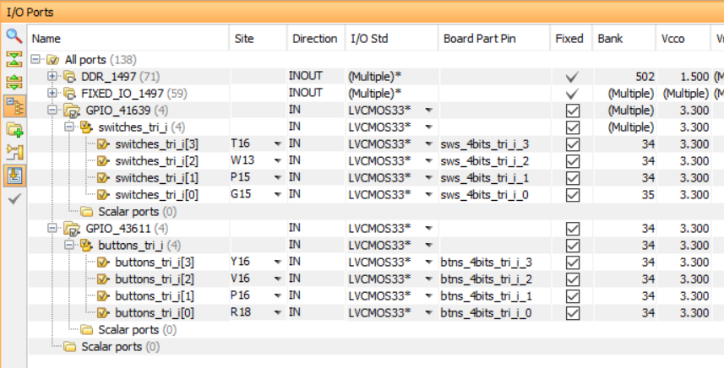
Lab #3 Part 2: switches and buttons are connected to I/O pins of Zynq
Click “Synthesized Design to see I/O Ports
Select Window->I/O Ports to open I/O Ports window if needed
Logical I/O wires (Names) are connected to physical I/O wires (Sites)
I/O voltage standard is LVCMOS33, i.e., 3.3V and low voltage CMOS

Slide 16
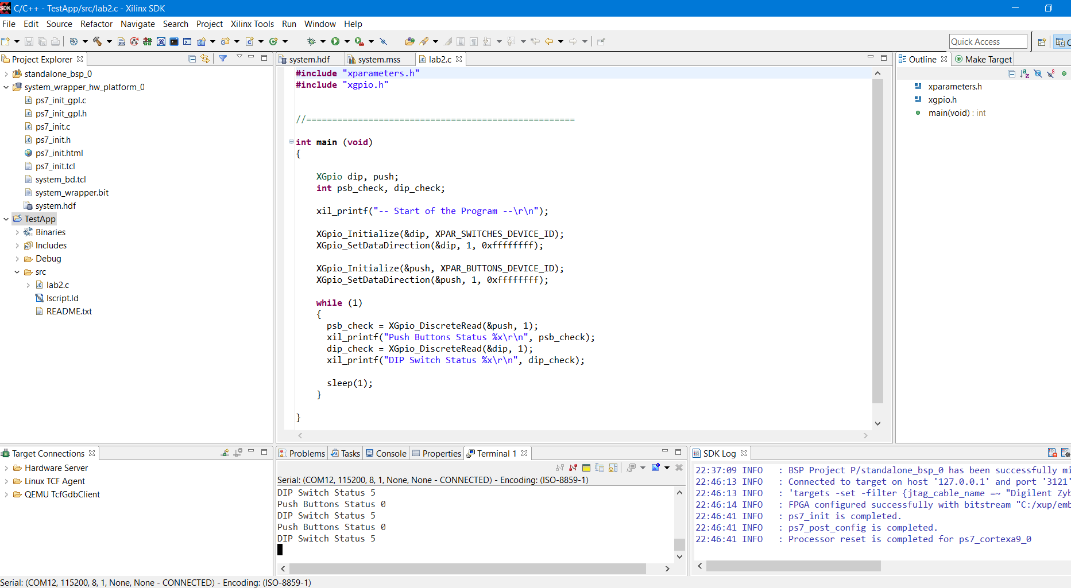
Lab #3 Part 2:: SDK and Terminal Display of Status
Status of Logic 1 or 0 of slide (DIP) switches and pushbutton switches are displayed on Terminal 1

Slide 17
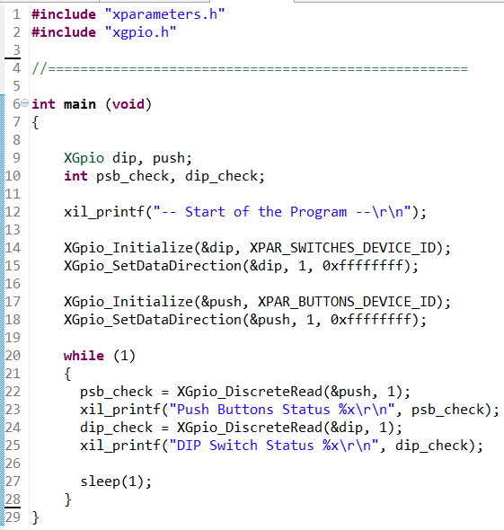
Lab #3 Part 2: lab2.c
object dip is an input register connected to slide switches
int dip_check is 4-bit value of slide switches
object push is an input register connected to button switches
int psb_check is 4-bit value of button switches
xil_printf() is a simplified version of printf()
dip and push need to be initialized and their direction need to be set
sleep(1) generates 1 sec delay

Slide 18
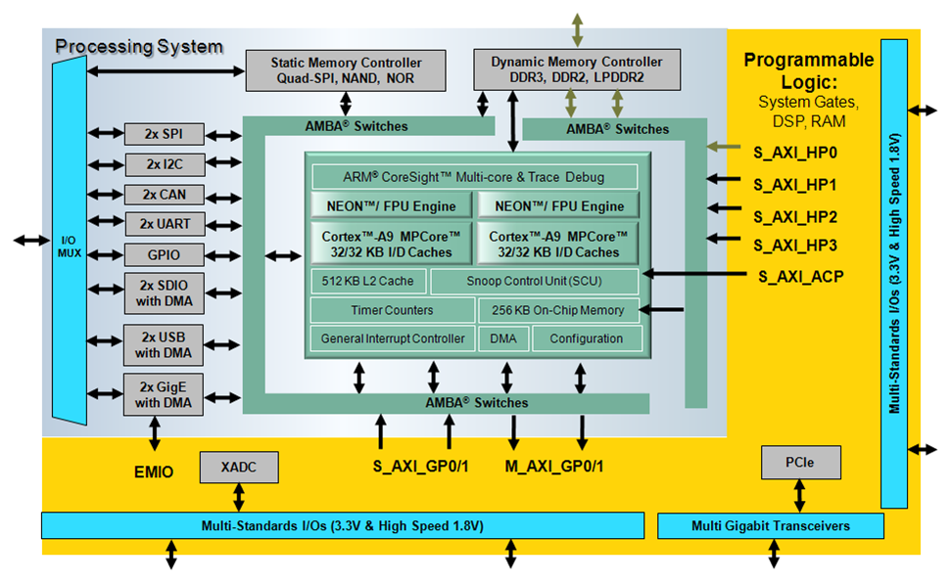
I/O Pins of Zynq-7010 System-on-a-Chip IC
128 PS IO pins=MIO + DDR
74 pin DDR
192 EMIO
SelectIO
54 MIO pins
100 SelectIO pins
100 PL SelectIO pins
© Copyright 2015 Xilinx

Slide 19
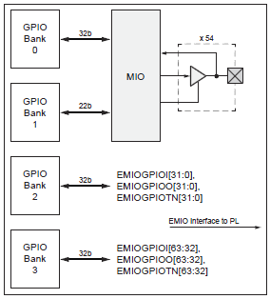
Total I/O Pins on ZYNQ XC7Z010-1CLG400C Chip
PS Side: 128 PS IO pins
54 GPIO signals for device pins (routed through the MIO multiplexer)
74 pins for memory management for DDR memory
PS-PL: 192 PS-PLGPIO signals between the PS and PL via the EMIO interface
64 Inputs
128 outputs (64 true outputs and 64 output enables)
PL Side: 100 PL SelectIO
They can form 48 differential pairs
Bidirectional, Hi-Z
ug585-Zynq-7000-TRM

Slide 20
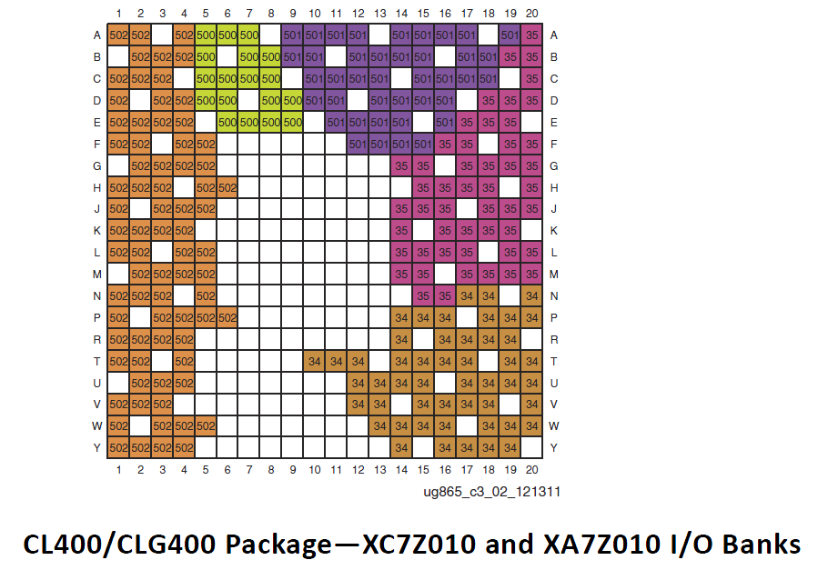
External I/O Pins on Ball Grid Array of YNQ XC7Z010-1CLG400C Chip
PS side: 128 PS IO pins on PS side
PS 500 and 501: 54 MIO pins
PS 502 are DDR pins: 74 memory interface pins
PL side: 100 SelectIO on PL side
Banks 34 and 35, 50 pins each
24 differential pairs in each bank
20x20 Ball Grid Array (BGA package CLG400)

Slide 22
GPIO Pins: General Purpose IOs Accessible by ARM Cores
Up to 54 GPIO signals for device pins routed through the MIO on ARM side
Outputs are 3-state capable
192 GPIO signals between the PS and PL via the EMIO
64 Inputs, 128 outputs (64 true outputs and 64 output enables)
The function of each GPIO can be dynamically programmed on an individual or group basis
Enable, bit or bank data write, output enable and direction controls
Programmable Interrupts on individual GPIO basis
Status read of raw and masked interrupt
Positive edge, negative edge, either edge, high level, low level sensitivities
Page 34, ug585-Zynq-7000-TRM

Slide 23
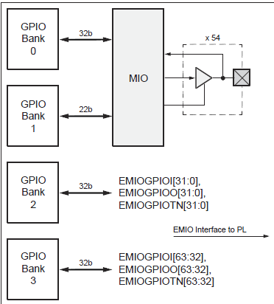
General Purpose I/O (GPIO) from PS to MIO and EMIO
Bank0: 32-bit bank controlling MIO pins[31:0]
Bank1: 22-bit bank controlling MIO pins[53:32]
Bank2: 32-bit bank controlling EMIO signals[31:0]
Bank3: 32-bit bank controlling EMIO signals[63:32]
54 GPIO signals for device pins (routed through the MIO multiplexer)
Outputs are 3-state capable
192 GPIO signals between the PS and PL via the EMIO interface
64 Inputs
128 outputs (64 true outputs and 64 output enables)
Page 281, ug585-Zynq-7000-TRM

Slide 24
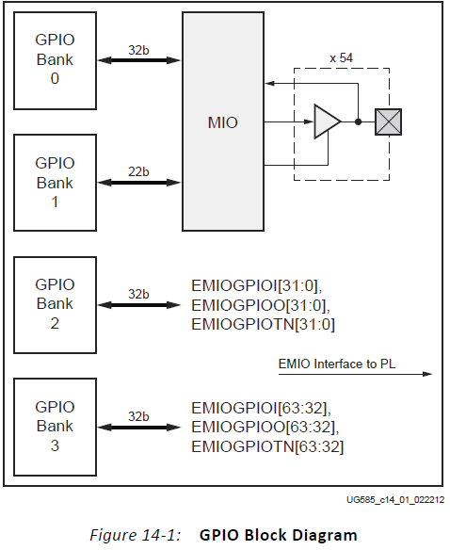
Drivers for Banks 0 and 1 for MIO and Banks 2 and 3 for EMIO
XGPiops drivers
GPIO Bank 0 and Bank 1 are connected to MIO in PS
Bank 0 is 32 bits
Bank 1 is 22 bits
GPIO Bank 2 and Bank 3 are connected to EMIO in PL
Bank 2 is 32 bits
Bank 3 is 32 bits
The control for each bank is the same
there are minor differences between the MIO and EMIO banks due to their differing functionality.
XGPio drivers

Slide 25
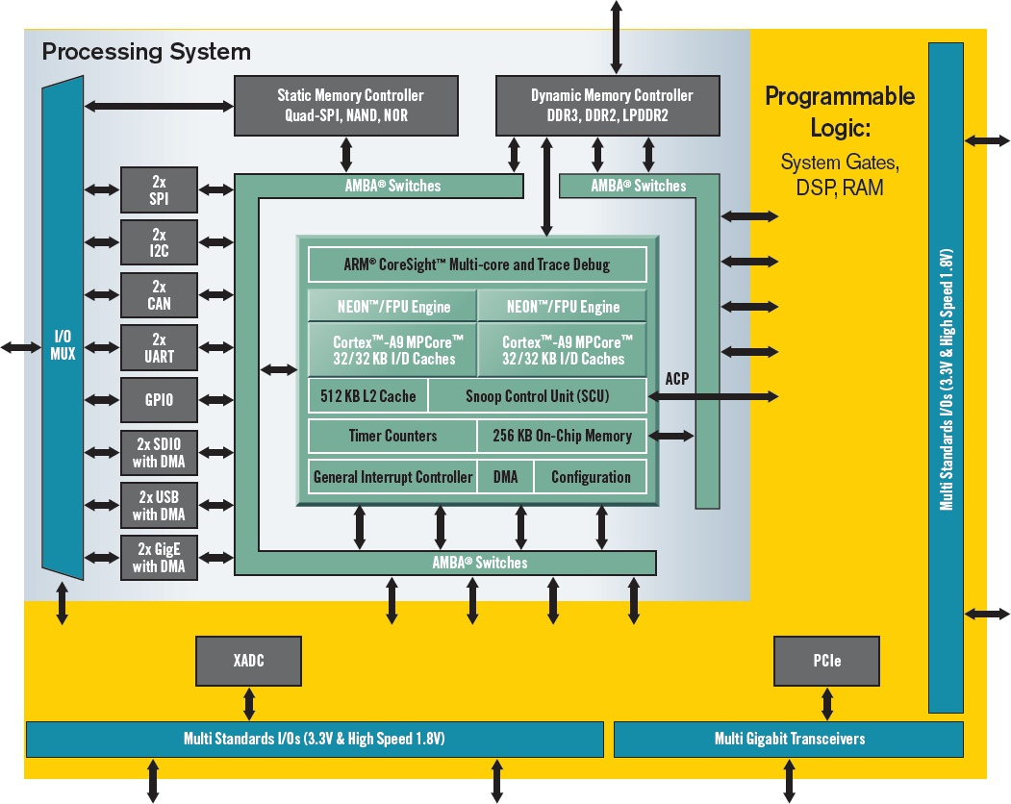
Multiplexed I/O (MIO) Pins from PS Peripherals
Bank 0
pins 0:15
Bank 1
pins 16:53
MIO Pins 0 to 53

Slide 26
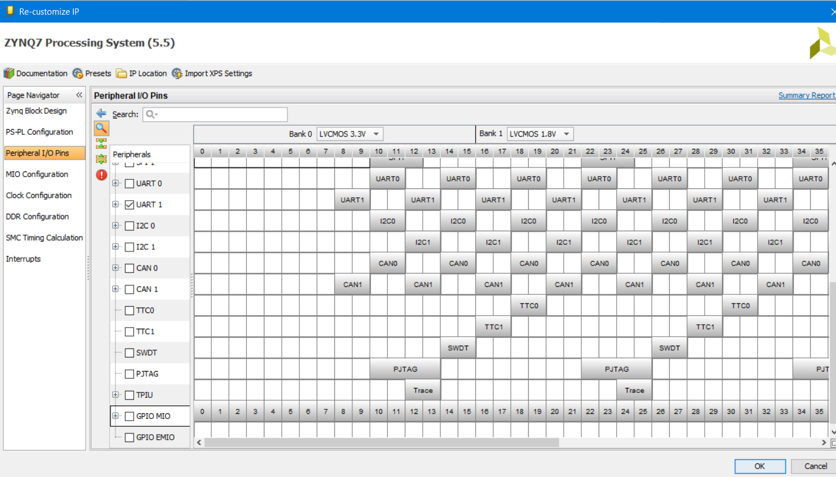
Multiplexed I/O (MIO) Pins from PS Peripherals
Double click on ZYNQ7 Processing System Block to open “Re-customize IP” menu. Click on “Peripheral I/O Pins” to see all MIO pins

Slide 27
SelectIO: User IO pins on the PL Side
ZYNQ XC7Z010-1CLG400C has 100 SelectIO pins on PL side
SelectIO pins can be configured to various I/O standards, both single-ended and differential.
Single-ended I/O standards (e.g., LVCMOS, LVTTL, HSTL, PCI, and SSTL)
Differential I/O standards (e.g., LVDS, Mini_LVDS, RSDS, PPDS, BLVDS, and differential HSTL and SSTL)
SelectIO pins are not directly accessible by ARM cores.
SelectIO pins can be accessed as EMIO pins by ARM cores through AXI interconnects.
How to ARM cores access Select I/O pins?
192 Virtual EMIO wires === 100 Select Hardware I/O pins
Page 628, ug585-Zynq-7000-TRM

Slide 28
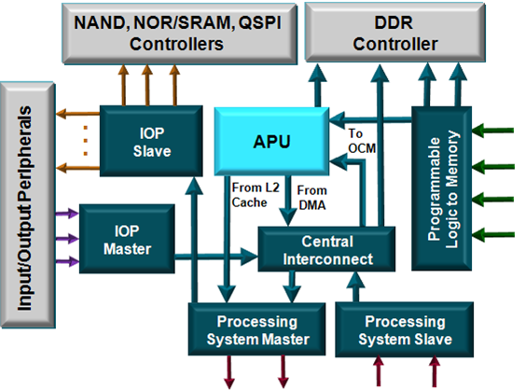
Processing System Interconnects within PS
Programmable logic to memory
Two ports to DDR
One port to OCM (on-chip-memory) SRAM
Crossbar Central interconnect
Enables other interconnects to communicate (Inter-State Highway)
Peripheral master
USB, GigE, SDIO connects to DDR and PL via the central interconnect (state road)
Peripheral slave
CPU, DMA, and PL access to IO peripherals (local road)
ug585-Zynq-7000-TRM

Slide 29
PS-PL Interfaces
One 64-bit accelerator coherence port (ACP) AXI slave interface to CPU memory
DMA, interrupts, events signals
Processor event bus for signaling event information to the CPU
PL peripheral IP interrupts to the PS general interrupt controller (GIC)
Four DMA channel RDY/ACK signals
128 Extended multiplexed I/O (EMIO) pins allow PS peripheral ports access to PL logic and device I/O pins
Clock and resets
Four PS clock outputs to the PL with enable control
Four PS reset outputs to the PL
Configuration and miscellaneous
ug585-Zynq-7000-TRM

Slide 30
Processing System Interconnect between PS and PL
Processing System Master (State road)
Two ports from the processing system to programmable logic
Connects the CPU block to common peripherals through the central interconnect
Processing System Slave (Local road)
Two ports from programmable logic to the processing system
ug585-Zynq-7000-TRM

Slide 31
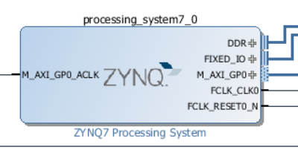
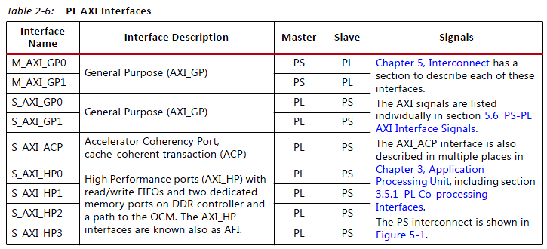
PS-PL Interfaces: Nine Interface Ports
Two General Purpose Master Ports
Two General Purpose Slave Ports
One Accelerator Coherency Port
Four High Performance Ports
ug585-Zynq-7000-TRM

Slide 32
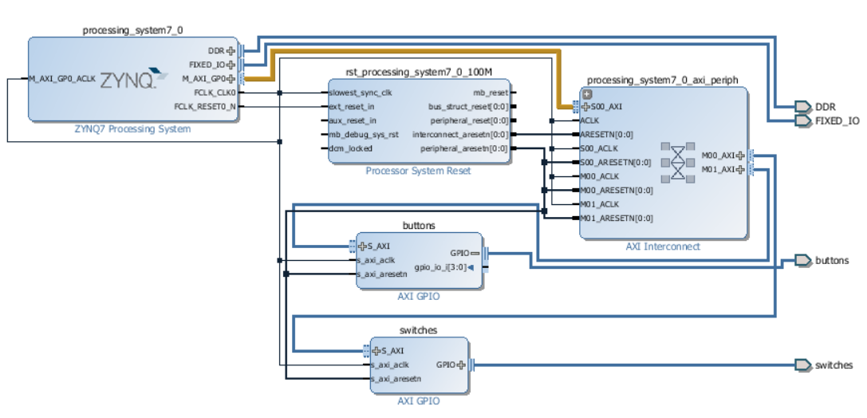
PS-PL Interfaces: Interface Ports, Cross-bar Network, I/O Interfaces
ARM uses M_AXI_GP0 to talk to AXI Interconnect Cross-bar network
AXI Cross-bar network talks to I/O interfaces
I/O interfaces talk to buttons, switches, etc.

Slide 33
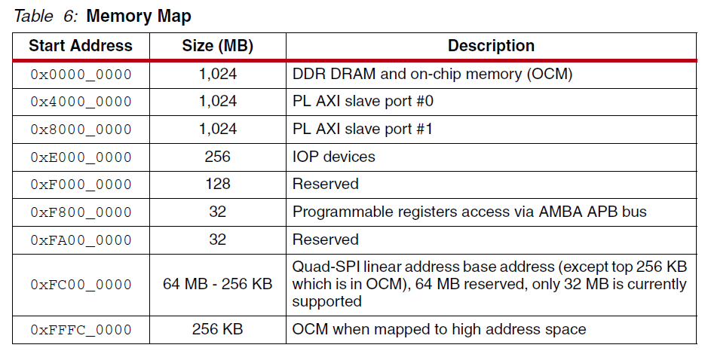
Memory Space on ZYNQ XC7Z010-1CLG400C Chip
All ports and devices are seen as memory addresses by ARM CPU
ARM Cortex-A9 implements ARMv7-A architecture with a single, flat 32-bit address space, i.e., von Neumann architecture
ug585-Zynq-7000-TRM

Slide 34
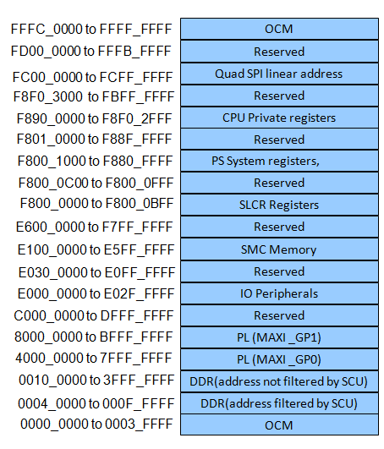
Memory Map of ARM Cortex-A9 Processor
The Cortex-A9 processor uses 32-bit addressing
All PS peripherals and PL peripherals are memory mapped to the Cortex-A9 processor cores
All slave PL peripherals will be located between 4000_0000 and 7FFF_FFFF (connected to GP0) and 8000_0000 and BFFF_FFFF (connected to GP1)
ug585-Zynq-7000-TRM

